Slide 1

SOVEREIGN ENGINE / ASSURANCE BRIEF
Tᵢⱼₖ = Tᵢₖⱼ
Governed Source Intake & Tensor Symmetry
1
2
3
2
4
5
3
5
6
From protected source bytes to a bounded, replayable structural receipt.
A finite slice can be inspected exactly. Authority remains with the deterministic verifier.
SCOPE: source retention · declared schema · finite predicate NOT A THEORY, SEMANTIC, OR EMPIRICAL VERDICT

Slide 2

OPERATING PRINCIPLE / SEPARATE AUTHORITY
One file. Three different decisions.
01 / RETAIN
02 / VALIDATE
03 / REVIEW
Can we store these bytes?
Does the file match its declared schema?
Should source metadata be published?
Owner-gated intake accepts a declared source only after protected transport and storage checks.
A pure validator checks finite structure, identifiers, coordinates, and count invariants.
The existing independent review gate evaluates a proposed archive record separately.
OUTPUT → SOURCE RECORD
OUTPUT → ACCEPTED / REJECTED REPORT
OUTPUT → REVIEW DECISION
NONE OF THESE OUTPUTS IS A SCIENTIFIC, SEMANTIC, OR THEORY-LEVEL VERDICT.

Slide 3
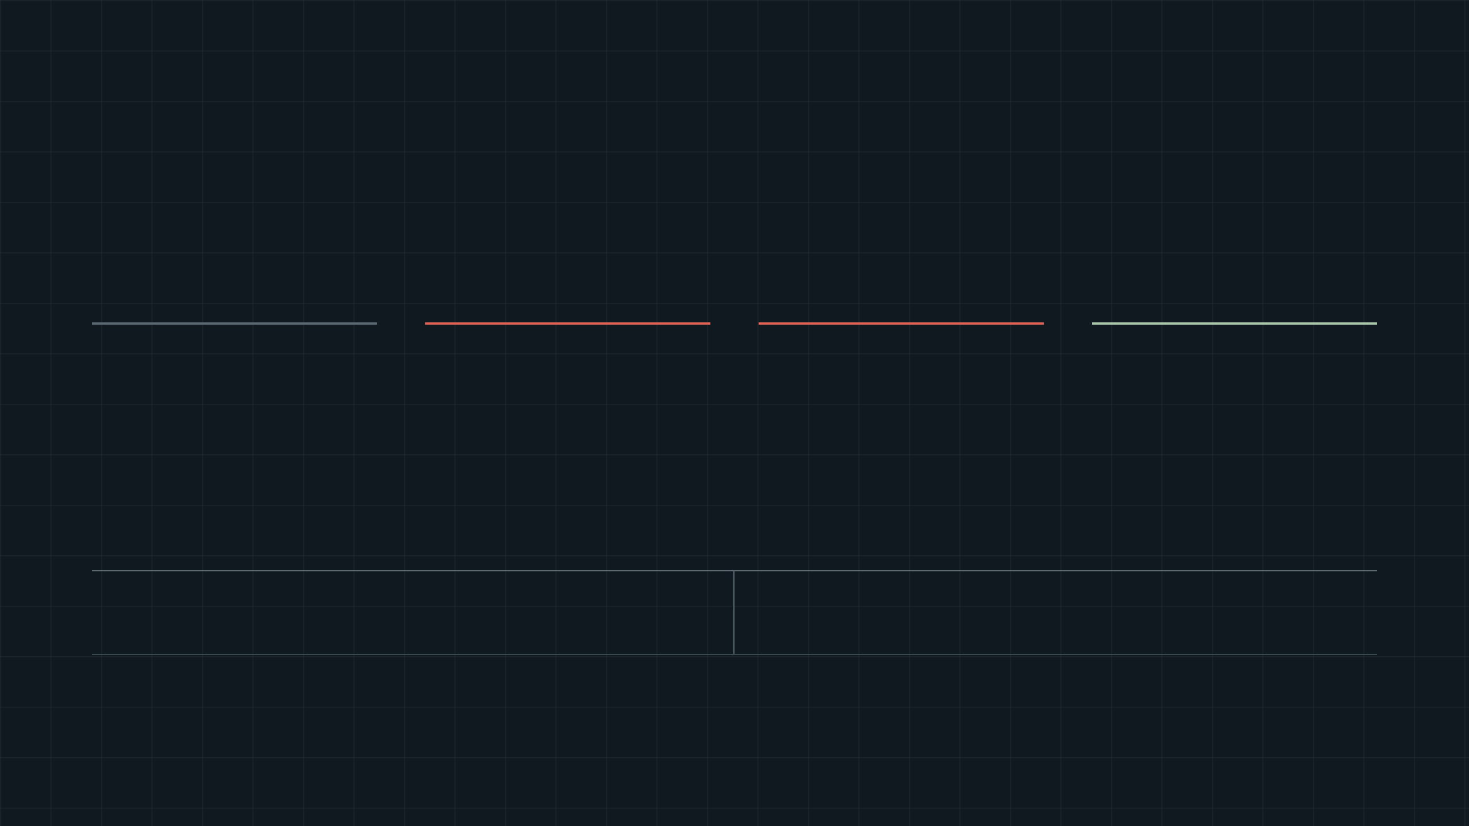
GOVERNED INTAKE / SERVER-ONLY CREDENTIALS
The browser selects. The server decides.
Raw declared JSON bytes cross a protected server boundary before managed retention. Source acceptance is structurally bounded and is never an archive-publication or evidence verdict.
→
→
→
CLIENT
PROTECTED SERVER
PROTECTED SERVER
MANAGED STORAGE
File selection
Owner-gated route
Generated key
Object + intake record
One declared JSON source role and one local file.
Authorize request, cap size, parse bytes, validate schema, compute SHA-256.
The server—not the browser—chooses the object key and content type.
Retain bytes; persist URL, digest, report, actor, and time in durable metadata.
Browser never receives: object-store credentials or final object-key authority.
Upload never means: verified evidence, publication, or an interpretive conclusion.
/manus-storage/{server-issued-key} becomes a provenance pointer only after a durable intake record exists.

Slide 4
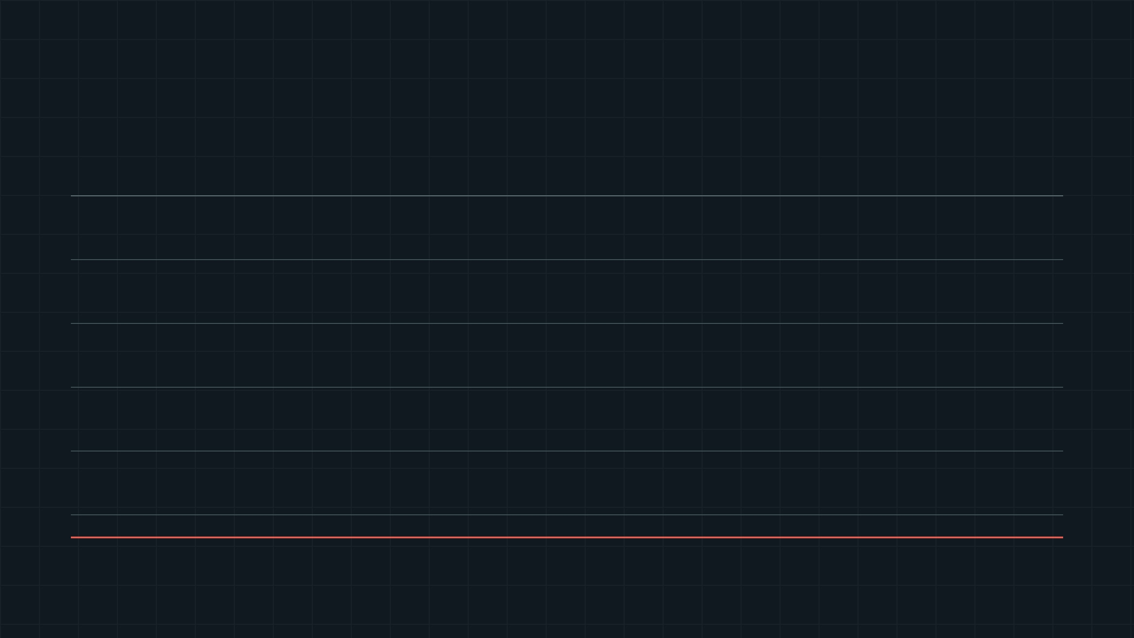
SOURCE INTAKE / FAILURE IS AN EXPLICIT STATE
Fail closed before retention.
Each gate rejects a defined invalid condition before it can become a governed source reference.
01 · Authorization
REJECT
Prevents ungoverned source intake and blocks untrusted actors before file parsing.
Missing or invalid owner authority
02 · Format & size
REJECT
Prevents source substitution, unsafe path input, and resource-abuse payloads.
Wrong role, filename, MIME, empty or oversized bytes
03 · Declared structure
REJECT
Preserves the declared finite grammar; an invalid source is not silently normalized.
Malformed JSON, invalid URIs, coordinates, or letters
04 · Managed storage
REJECT
Avoids presenting a source pointer when exact bytes were not retained successfully.
Storage failure or malformed provider response
05 · Durable intake linkage
RETAIN
Only this state yields a traceable source record. Publication remains a separate review decision.
Storage result and durable metadata row agree
REJECTED INPUT → NO PUBLIC RECORD · NO AUTOMATIC VERDICT · NO SILENT FALLBACK
The control governs bytes and declared structure only. It does not interpret corpus content or establish a research conclusion.

Slide 5
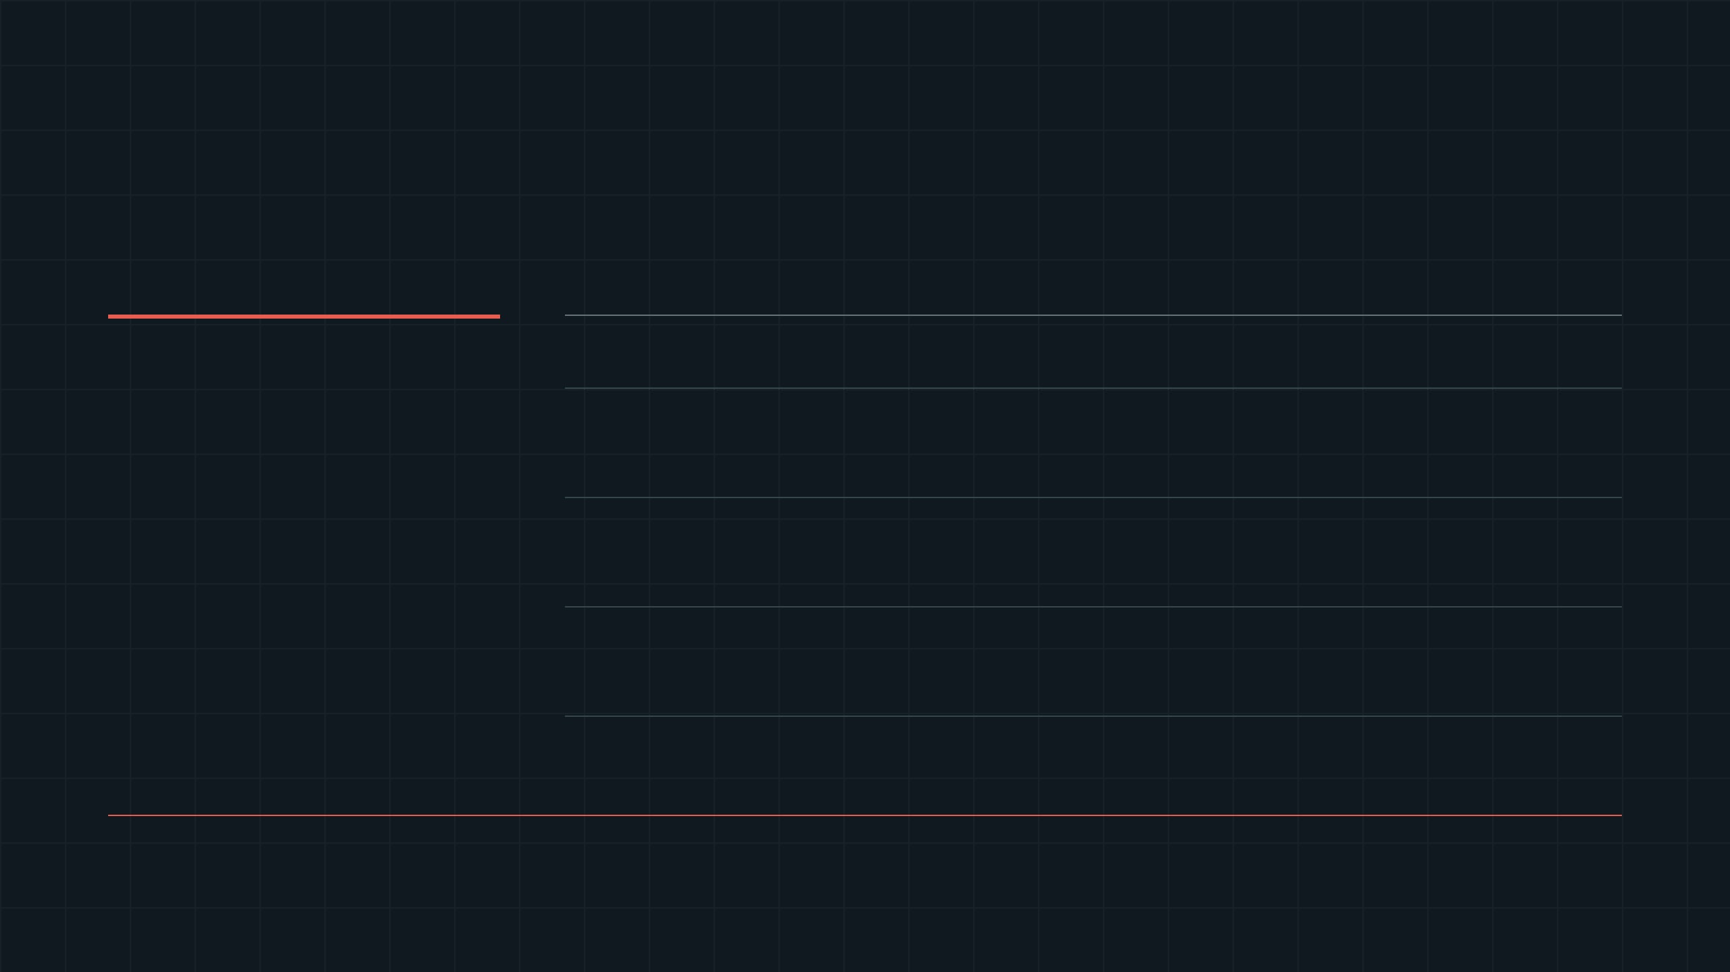
LIVING WORD SOURCE GATE / OBSERVED TEST RUN
15 structural checks passed.
The supplied files met the declared source-format contract. The result is a structural acceptance record, not an interpretation of the texts.
PYTEST RESULT
DECLARED SOURCE
RESULT
STRUCTURAL CHECKS
15/15
Genesis OSHB
6 / 6
Presence · JSON parse · ≥8,086 words · URI and letter grammar · opening record · no empty surfaces
PASS · 0 SKIPPED
John SBLGNT
6 / 6
Presence · JSON parse · ≥15,438 words · URI and letter grammar · opening record · no empty surfaces
Observed suite runtime 0.81 seconds Files installed at the legacy runtime’s expected source paths.
Text URI round-trip · letter URI round-trip · deterministic 64-character fingerprint
URI protocol
3 / 3
INTERPRETATION BOUNDARY
Passing confirms only that these supplied bytes conform to declared data structure and protocol expectations. It does not establish semantic, theological, historical, empirical, medical, or theory-level claims.

Slide 6

SOURCE-INTAKE VALIDATOR / NEGATIVE CONTRACT
FAIL CLOSED BEFORE STORAGE BEFORE PUBLICATION
Negative tests define the contract.
A source is accepted only after named rejection boundaries have been exercised. Each failure has a precise code, a narrow scope, and no implied interpretation.
01 / METADATA
Unsupported source role · unsafe filename · role/file mismatch · empty or oversized bytes
INPUT REJECTED
E_CORPUS_*_INVALID
02 / PAYLOAD
Malformed JSON · non-array root · below word floor · missing required word fields
PAYLOAD REJECTED
E_CORPUS_JSON_INVALID
Bad URI grammar · invalid coordinates · empty letters · malformed character · count mismatch
SCHEMA REJECTED
03 / STRUCTURE
E_CORPUS_*_MISMATCH
≠
Accepted means the supplied bytes match a declared structural schema. It does not mean verified evidence, publication approval, or a theory-level result.

Slide 7
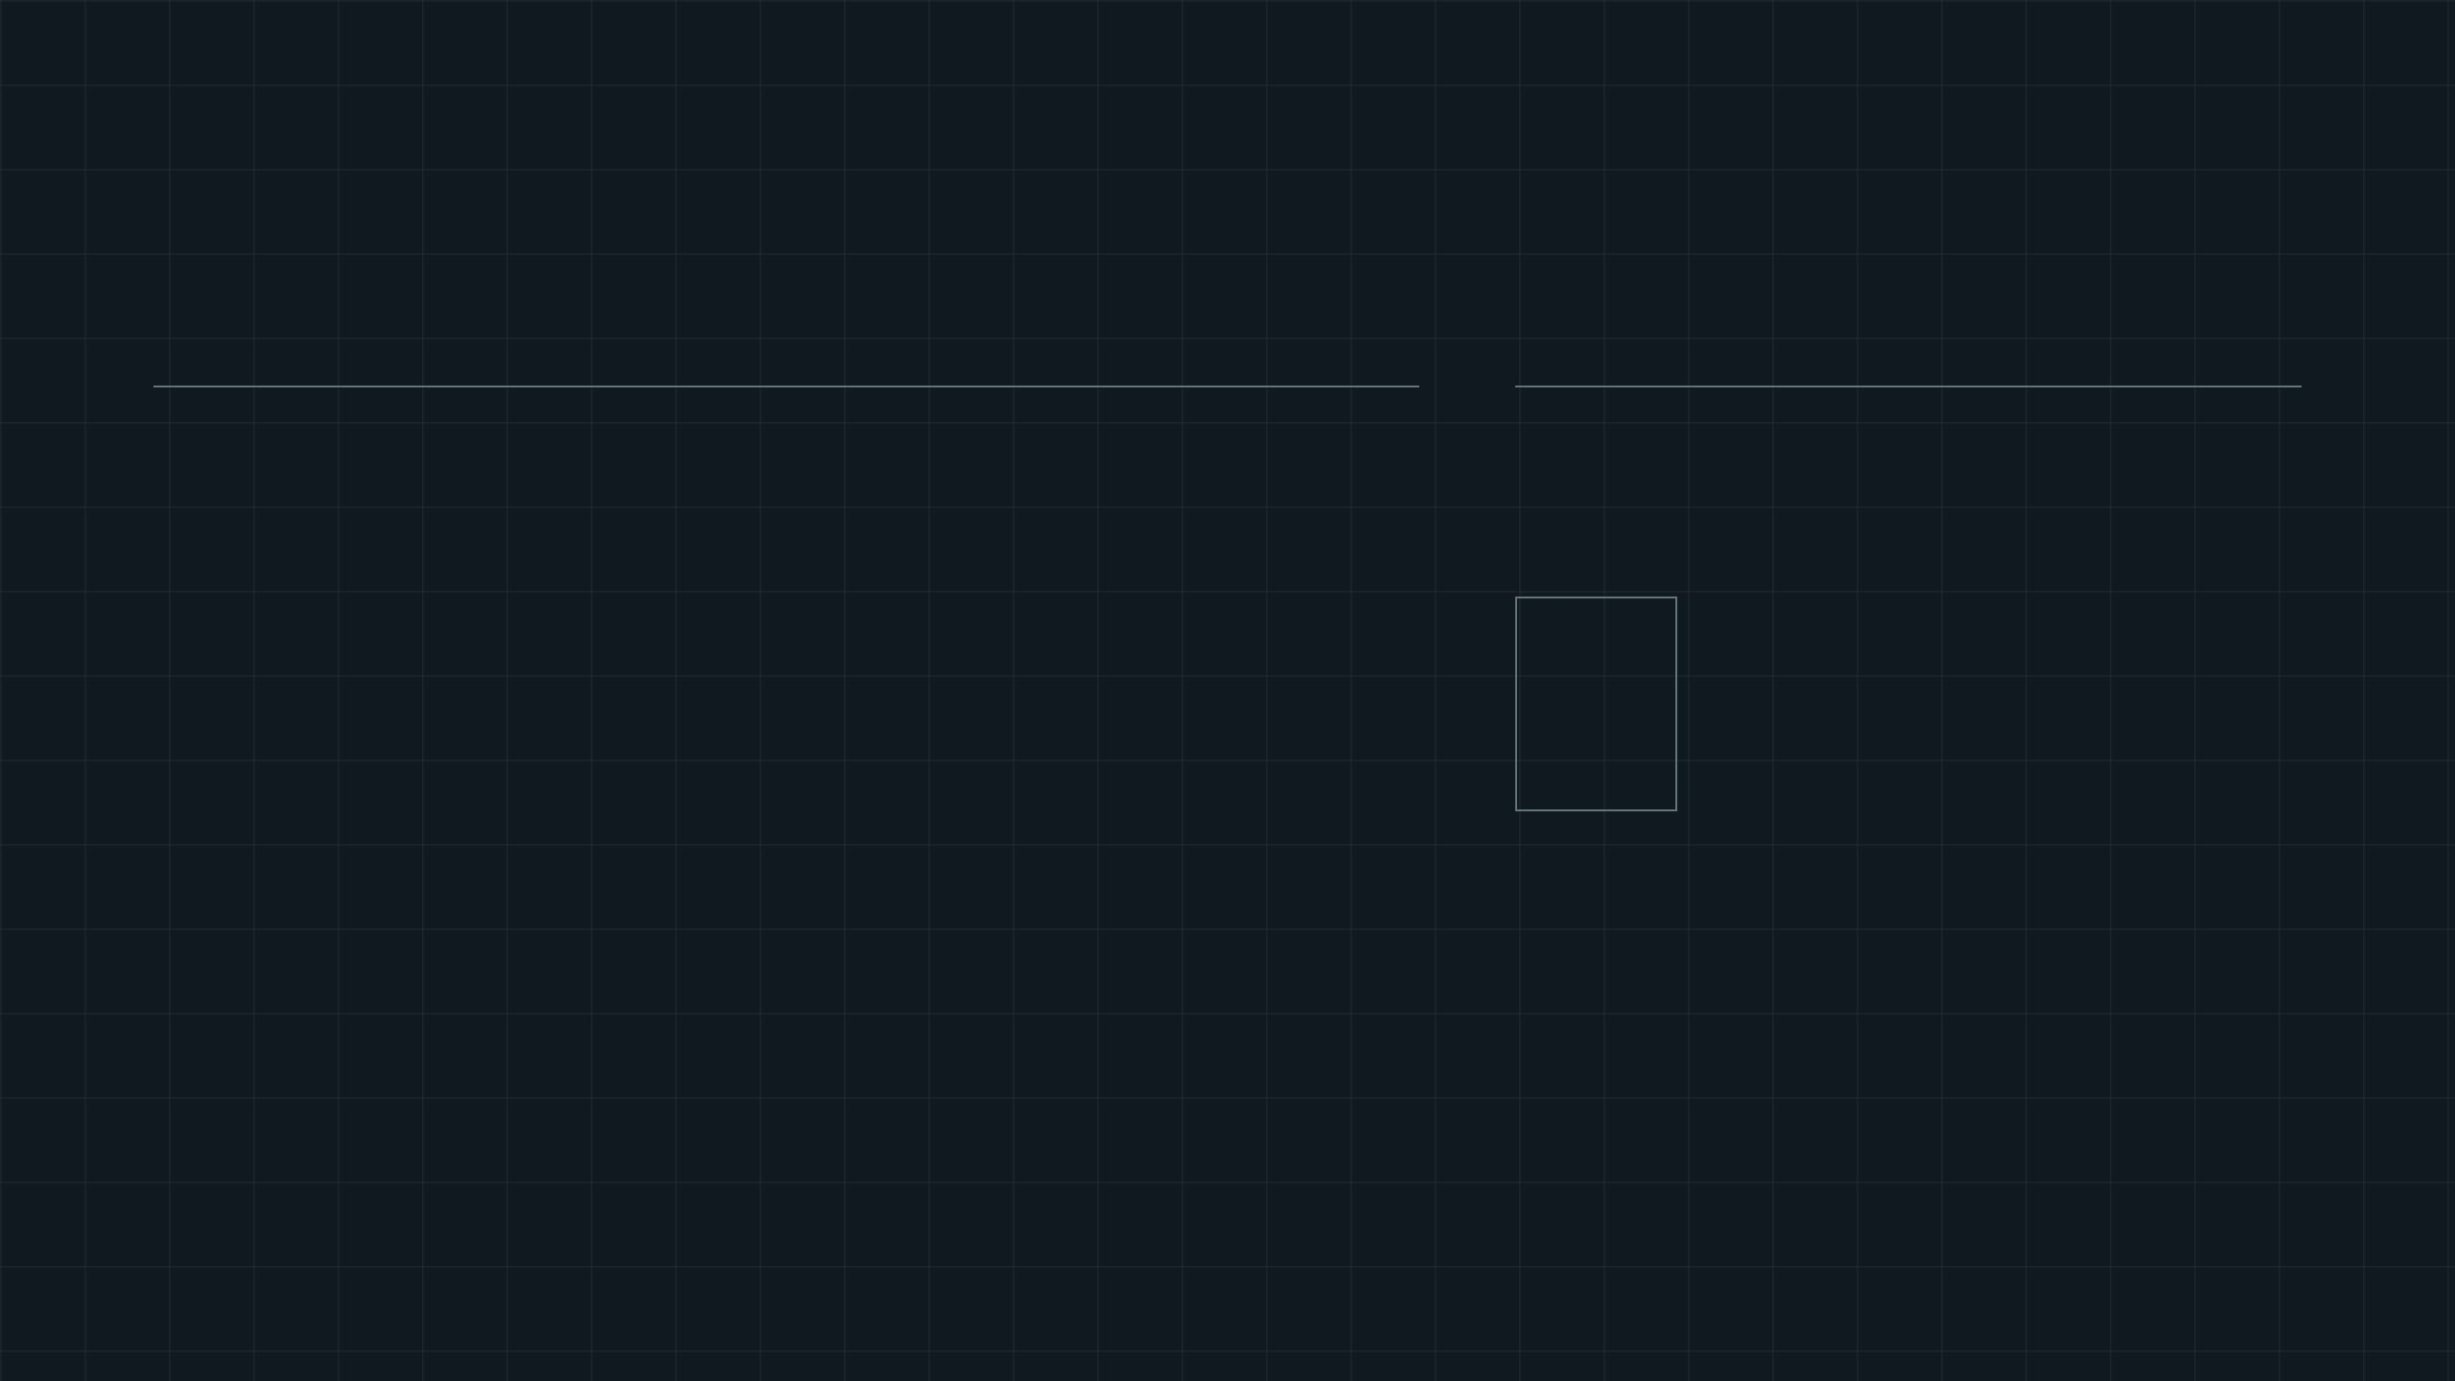
UNIVERSAL KERNEL / DECLARED FINITE PREDICATE
The declared tensor predicate
FINAL-INDEX SYMMETRY
FIX i · COMPARE MIRRORED FINAL-INDEX PAIRS
T
=
T
_{i j k}
_{i k j}
Tᵢ₀₀
Tᵢ₀₁
T
_{i01}
= T
_{i10}
↔
The diagonal is unchanged by the swap. Only one off-diagonal triangle needs testing.
Tᵢ₁₀
Tᵢ₁₁
For every fixed first index i, swapping only the final two indices must preserve the declared component value.
Each fixed-i slice behaves as a symmetric matrix in the j,k coordinates.
DOMAIN: a finite rank-three numeric array SHAPE: (d₀, n, n) COMPARISON: exact equality of supplied components
WHAT IT ESTABLISHES
WHAT IT DOES NOT ESTABLISH
Whether the supplied finite values satisfy this one equality relation.
A physical tensor field, coordinate invariance, full permutation symmetry, or a
theory-level conclusion.

Slide 8
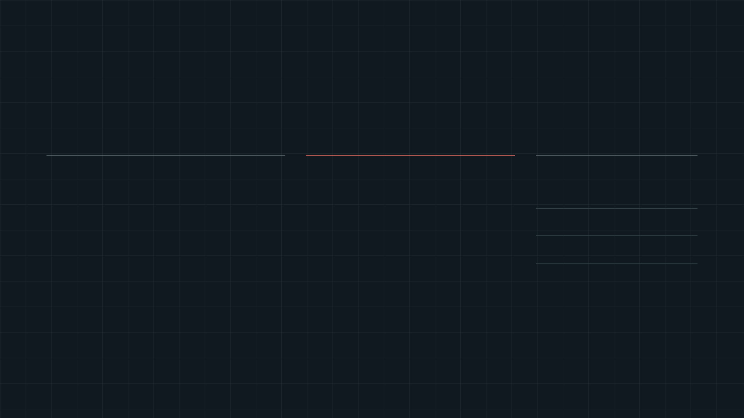
FINITE PREDICATE / FAILURE WITNESS
A failure produces a witness.
The verifier reports the exact pair that violates the declared final-index symmetry. It does not infer a cause beyond the supplied finite values.
SLICE / i = 0
RECEIPT EVIDENCE
DECLARED RELATION
1
2
Mirrored entries disagree.
T
_{i j k}
= T
_{i k j}
AT
[0, 0, 1] → 2
3
4
For each fixed first index i, the remaining two-dimensional slice must equal its transpose.
MIRROR AT
[0, 1, 0] → 3
COMPARISON
2 ≠ 3
rows: j / columns: k
STATUS → FAIL
BOUNDARY: this failure is exact evidence that one declared equality does not hold for this input. It does not diagnose a legacy generator or establish any wider theoretical conclusion.

Slide 9
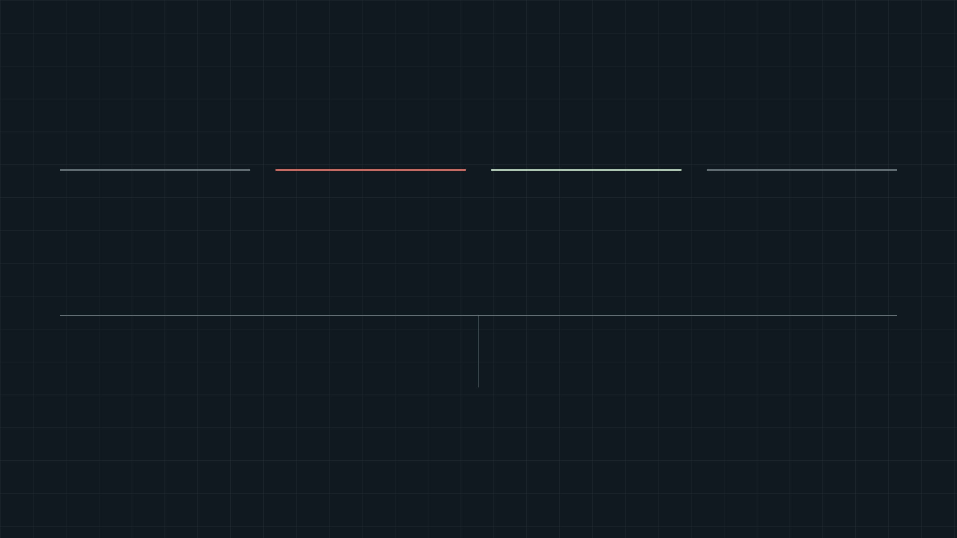
DUAL-KERNEL LOOP / AUTHORITY BOUNDARY
Quarantine preserves authority.
The legacy runtime may propose finite candidate values. It cannot authorize a verification result, import its own conclusions, or turn provenance into proof.
→
→
→
01 / LEGACY RUNTIME
02 / QUARANTINED ADAPTER
03 / UNIVERSAL KERNEL
04 / RECEIPT
Candidate
Reduction
Predicate
Bounded result
Opaque candidate ID and declared finite values enter the boundary.
Packages one neutral structural claim packet and explicit non-claims.
Evaluates only the declared finite relation, such as final-index symmetry.
verified · fail · unverifiable with replayable scope and witnesses.
AUTHORITY CUT → FRAMEWORK LABEL IS PROVENANCE, NOT ENDORSEMENT
ADAPTER MAY
ADAPTER MAY NOT
Validate the packet boundary. Normalize declared finite input. Identify the candidate and adapter version. State non-claims explicitly.
Validate a legacy ontology. Adopt a legacy conclusion. Establish empirical meaning. Upgrade a finite equality into a theory-level result.
RESULT SCOPE: a receipt confirms only whether the universal predicate holds for supplied finite input. The legacy runtime remains a candidate generator, not a verification authority.

Slide 10
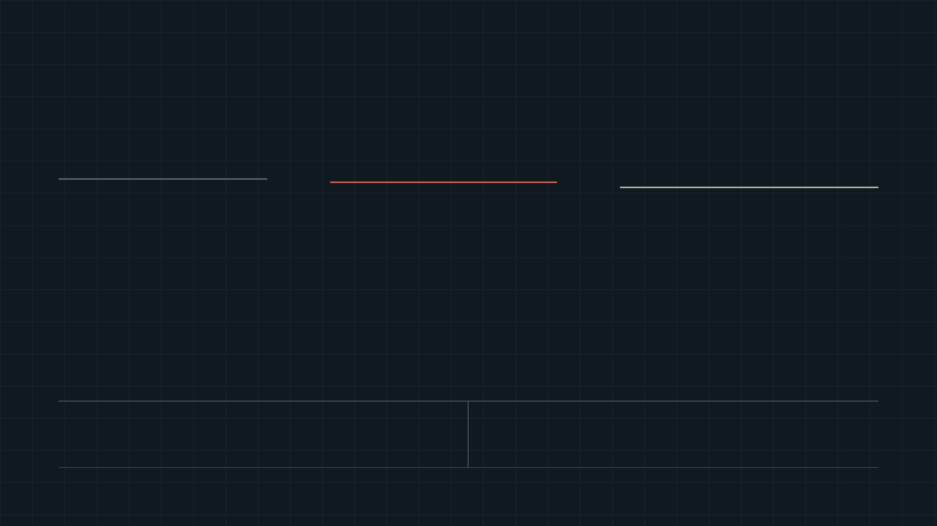
OPTIONAL ACCELERATION / AUTHORITY DOES NOT MOVE
GPU screening is not a verdict.
Parallel execution reduces screening time but cannot replace deterministic kernel evaluation that creates a replayable receipt.
01 / VECTOR SCREEN
02 / QUARANTINED RESULT
03 / AUTHORITY GATE
CPU NumPy or optional GPU CuPy
Candidate state only
Deterministic CPU kernel confirmation
→
Screening can locate mismatches and count them, but it produces no receipt.
→
Compare off-diagonal index pairs in parallel across declared finite tensor slices.
Re-evaluate the declared tensor through the universal structural predicate before issuing the result.
candidate_verified candidate_failed unavailable if GPU backend is absent
FAST PATH: upper-triangle pairs only
verified · fail · unverifiable
ACCELERATOR MAY
ACCELERATOR MAY NOT
Vectorize comparisons, identify a mismatch witness, return an unavailable state, and prioritize candidate work.
Issue a verification receipt, reinterpret candidate data, silently fall back from a requested GPU path, or promote a legacy conclusion.
AUTHORITY RULE: any result intended for evidence retention is recomputed by the deterministic kernel over the declared finite values.

Slide 11
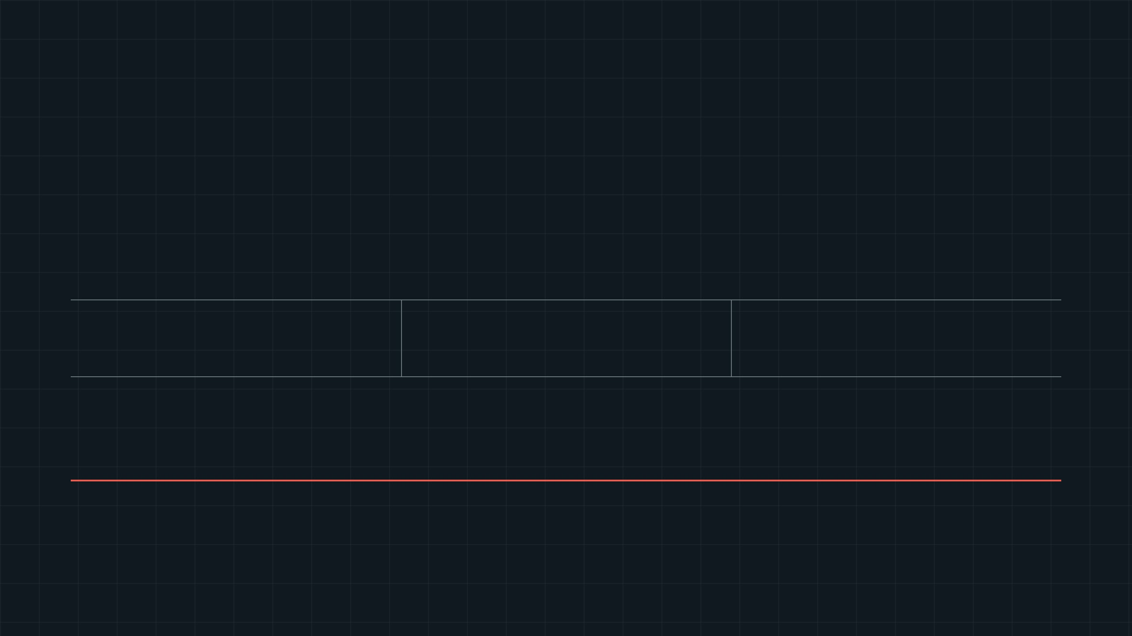
SOVEREIGN ENGINE / OPERATIONAL CLOSE
■ BOUNDED AUTHORITY PRESERVED
Retain. Reject. Verify.
Make every source boundary explicit, every malformed input inspectable, and every structural result replayable within its declared scope.
Retain
Reject
Verify
SERVER-GOVERNED SOURCE BYTES
NAMED SCHEMA FAILURE MODES
FINITE DETERMINISTIC PREDICATES
Declared source and source role
→
Validated bytes and durable intake record
→
Bounded receipt after confirmation
NEXT OPERATION
Exercise one owner-authorized live managed-storage upload. Keep GPU vector screening candidate-only; every receipt remains subject to deterministic CPU-kernel confirmation.

